Slide 1

EE5132 Wireless and Sensor Networks EE5024 IoT Sensor Networks
Group 05
Simulation Study of Variations to LEACH Protocol
Variation A
Zhu Qi (A0224460N)
Emil Yong Kai Wen (A0169907M)
Tang Yuyi (A0232683A)
Chen Zuona (A0224670J)
Faisal Ahmad (A0034178E)
Ivander Jonathan Marella Waskito (A0200825R)
Notes:
Good evening Prof and GA! We are group 5 studying Variation A to LEACH Protocol. I’m Faisal Ahmad and I’ll begin the presentation.

Slide 2
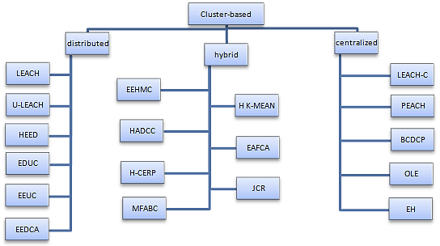
Scope
Part 1 – LEACH
Network Size Variation
Part 2 – Centralised Variations
LEACH-C
BCDCP
A. A. Hassan, W. Shah, M. F. Iskandar, and A. A.-J. Mohammed, “Clustering Methods for Cluster-based Routing Protocols in Wireless Sensor Networks: Comparative Study,” vol. 12, no. 21, p. 11, 2017.
Notes:
Our presentation will firstly cover the extension of the LEACH algorithm given to study the impact of network size on network performance. Next we will look at two other centralized clustering variations to LEACH protocol, namely, LEACH-C and BCDCP. In our literature survey, we studied various improvements suggested by other researchers in the clusterhead selection process. The protocols can be categorized into three categories: Distributed, Centralised, Hybrid. To summarise, the various Distributed protocols considered energy and distance ratios in various ways for the CH selection. But the clusterhead selection remains at the node. In Centralised Clustering, the selection is done at the base station using global knowledge of the nodes’ energy levels and location to form clusters. In both Distributed and Centralised approaches, researchers introduced various ways of CH to CH routing to improve energy usage. Hybrid protocols fuses approaches to further improve energy usage and suit specific network needs. From our literature research, we chose to focus on LEACH-C and BCDCP given that it had the most clarity and references in the papers studied.

Slide 3
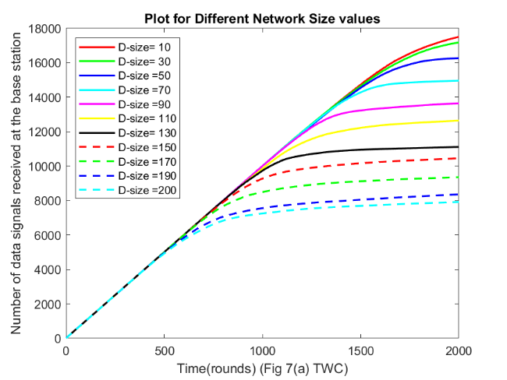
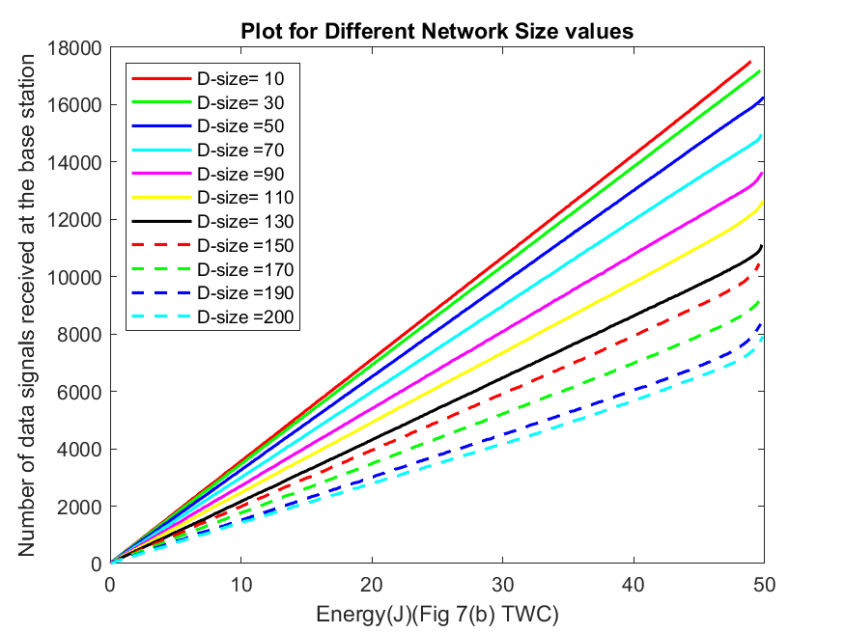
Part 1 – LEACH
Data delivery inversely proportional to network diameter
Less efficient data delivery in larger network
10m
200m
Notes:
Next, I will cover Part 1 – studying the impact of varying network sizes on LEACH performance. From the graphs, we can see that the number of the data packets received by the base station increases as network diameter decreases. For example, at 1500 rounds, a network with a diameter of 10 meters receives close to 15,000 data packets, almost twice as much as the 8,000 data packets received in a network diameter of 200 meters . This supports our theoretical understanding that in a larger network with the same number of nodes, the distances are larger, thus the energy expended per data packet is higher. This effect is seen in Figure on the right where the number of data packets reaching the BS is lesser for any given amount of energy when the network is larger.

Slide 4
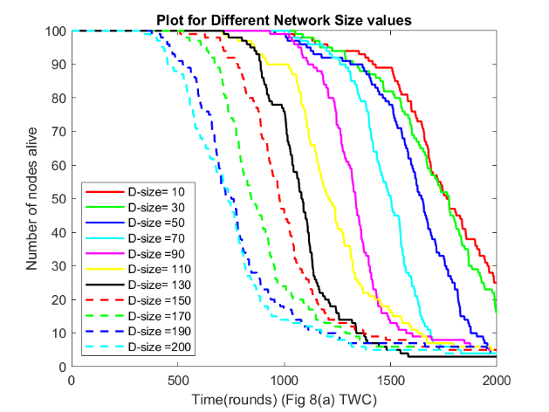
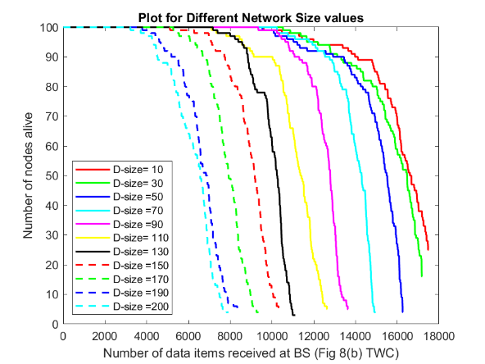
Part 1 – LEACH
Network life & total data delivery is lesser for larger networks
200m
10m
Notes:
The overall increase in energy expenditure for larger networks reduces the network lifespan as well as seen in the figures here. We define the system lifespan here based on first node death. The first node death occurs much earlier for larger networks. For example, for d=200m the first death occurs at less than 500 rounds, twice faster as compared to the smallest network with d=10m which has first death at 1000 rounds. We can also see in figure on the right that for larger networks, the higher energy usage and the resultant earlier first death leads to lesser overall data packets received at BS.

Slide 5
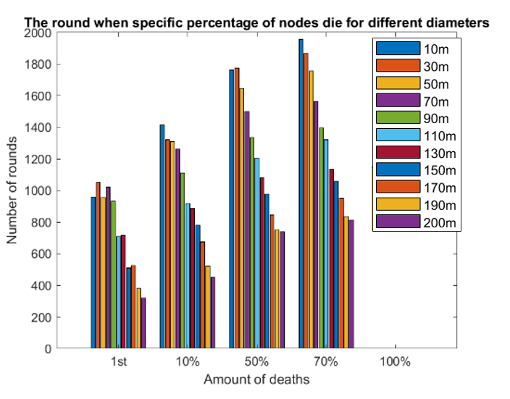
Part 1 – LEACH
LEACH increases longevity for smaller networks more than larger networks
Notes:
This graph shows the number of rounds at which the networks of various diameters attain the specified percentages of node deaths. We can see that the variance between the lowest and higher number of rounds at each percentage of node death increases as the percentage increases. We can observe again that the larger networks are more vulnerable to network death and LEACH seems to be work better at increasing the longevity of relatively smaller networks.
I’ll now pass on the time to Zuona.

Slide 6
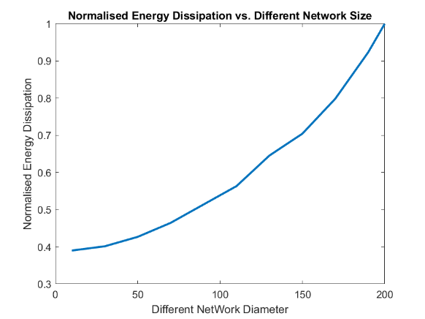
Part 1 – LEACH
Calculation of
Normalized Energy Dissipation:
1. Identify last rounds before any death occurs for different diameters.
2. Get the minimum round index.
3. Get the accumulated consumed energy at this minimum round index for different diameters.
4. Normalization: divide each energy value by the maximum value.
Exponential growth due to:
Energy ∝distance^2 or distance^4
Notes:
In the figure 4f, we need to calculate normalized energy dissipation.
First, we Identify last rounds before any death occurs for different diameters.
Among those indexes, Get the minimum round index.
Then, Get the accumulated consumed energy at this minimum round index for different diameters.
Finally, to conduct Normalization, divide each energy value by the maximum value.
From the curve, we can see that its shape corresponds to exponential growth.
This is because the consumed energy is proportional to square of distance or 4th power of distance.

Slide 7
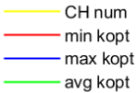
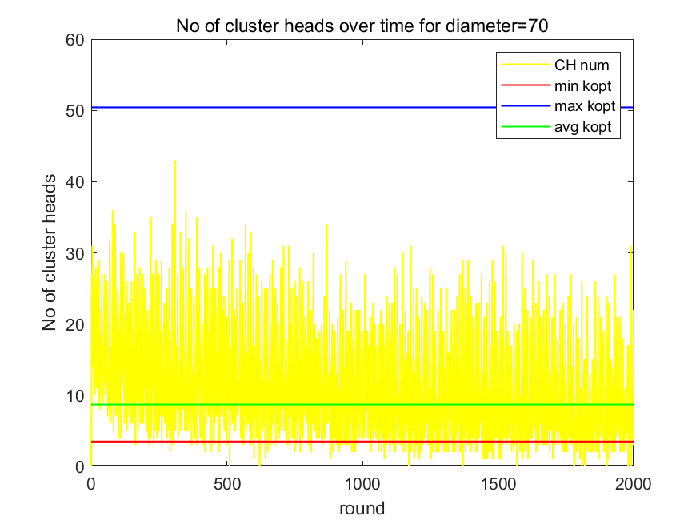
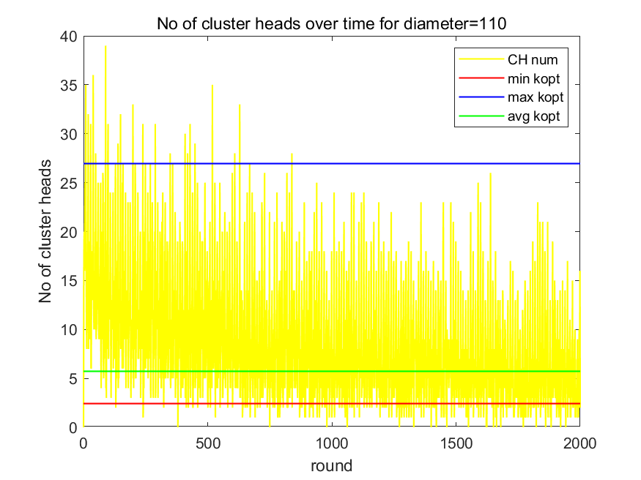
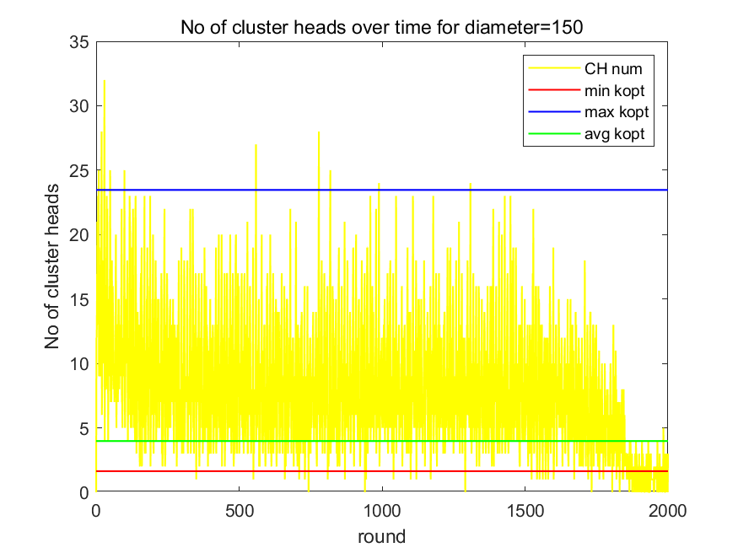
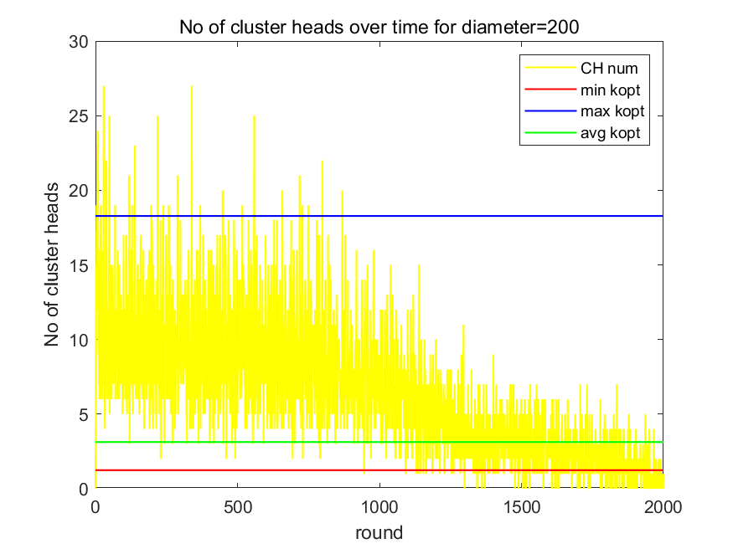
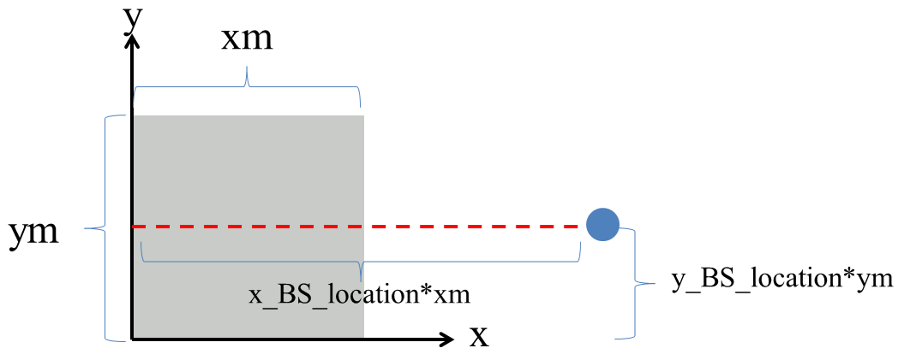
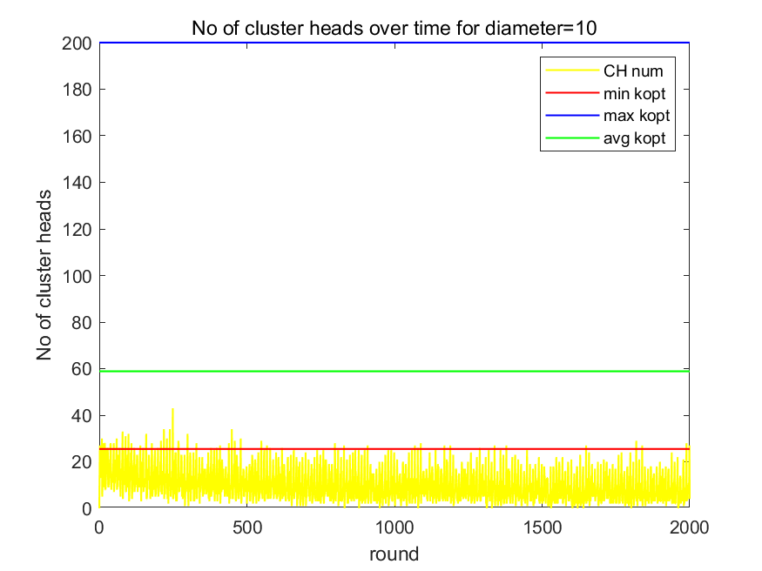
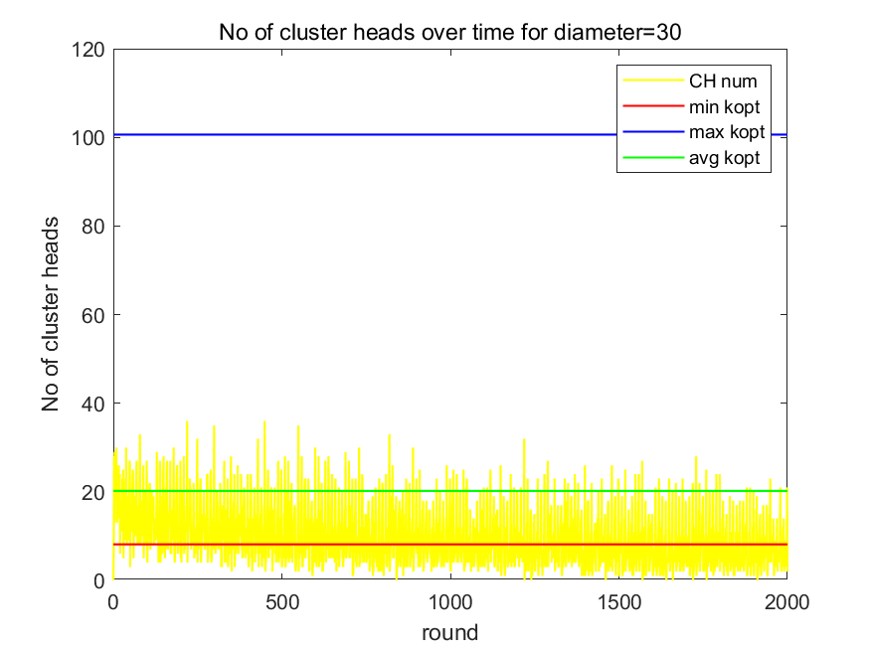
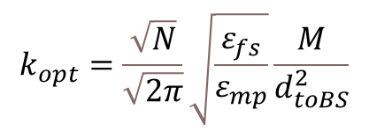
Part 2 – BS Location
Experiment 1: BS outside network (not very far from network)
D=70
D=110
Optimum k (number of clusters)
Num of nodes
Network diameter
D=150
D=200
$$k_{opt}=\frac{\sqrt{N}}{\sqrt{2π}}\sqrt{\frac{ε_{fs}}{ε_{mp}}}\frac{M}{d_{toBS}^{2}}$$
Distance between node and BS
x_BS_location=1.35
y_BS_location=0.5
Abnormality
D=10
D=30
Notes:
Now ……..The theoretic optimum number of clusters is given as the equation in the paper, which is calculated by setting the derivative of total energy with respect to cluster number.
N is the number of nodes, M is the network diameter, dtoBS is the distance between node and base station,
Epsilon_fs is the power amplifier of free space model, and epsilon_mp is the power amplifier of multipath model.
The yellow curve corresponds to actual number of clusters for every round.
Blue line is upper bound of optimum k. Red line is lower bound. Green line is the avarage.
For the first experiment, the BS is outside of network, but not very far from network.
When the network diameters are between 70 and 200, the numbers of clusters for all rounds are roughly all within the theoretical optimum k range.
From these figures, we can see that:
The numbers of CHs are mostly within the calculated optimal k range.
For large network diameters, many nodes die in later rounds because of long distance’s energy consumption, which results in very few or zero CHs.
The upper bound of range decreases, when diameter increases.
However, when network diameter is very small i.e. high node density, the theoretical optimum k range is larger than the actual number of clusters.
This abnormality will be explained in later slides.

Slide 8
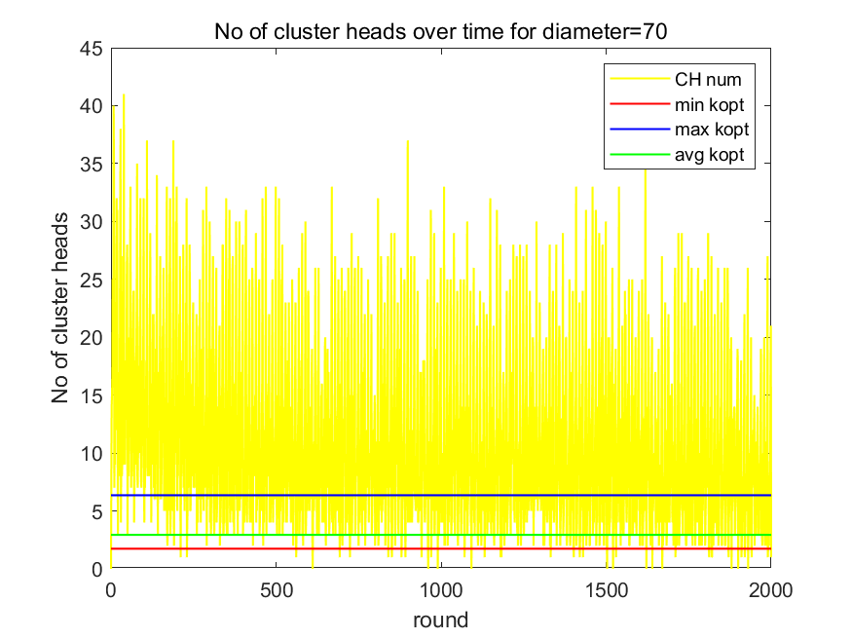
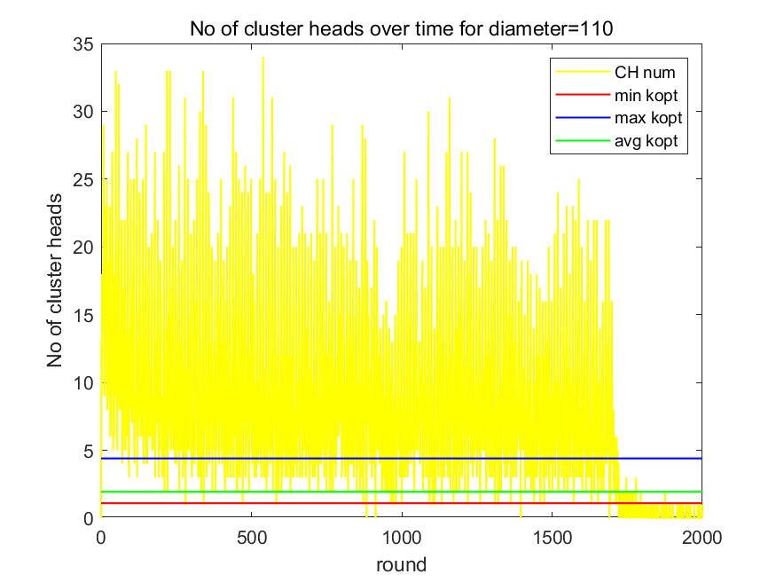
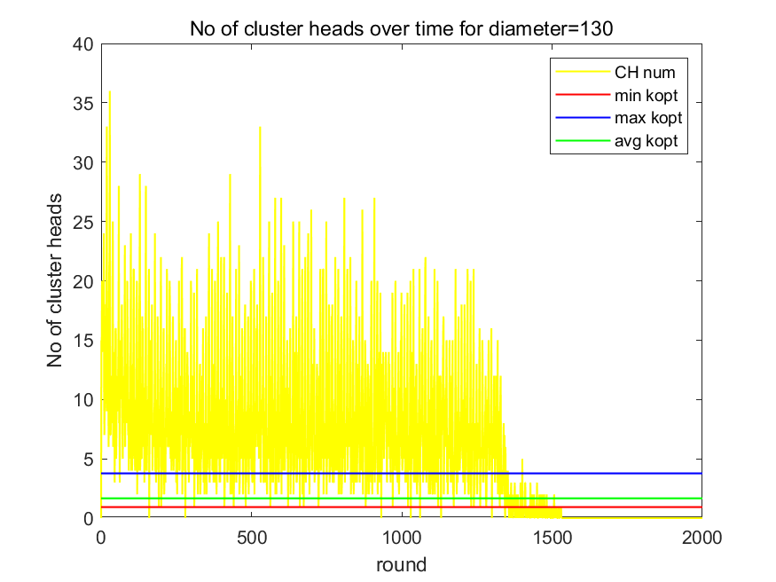
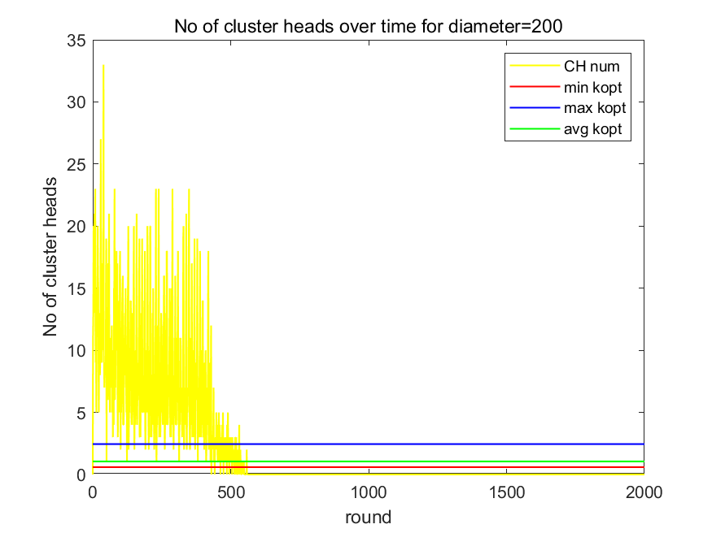
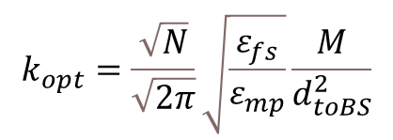
Part 2 – BS Location
Experiment 2: BS outside of network, far from network
$$k_{opt}=\frac{\sqrt{N}}{\sqrt{2π}}\sqrt{\frac{ε_{fs}}{ε_{mp}}}\frac{M}{d_{toBS}^{2}}$$
x_BS_location=2
y_BS_location=0.5
Notes:
For the 2nd experiment, we can see that when base station is far from network, the theoretical optimum k range does not match the actual number of clusters. The theoretical value is smaller than the actual one.

Slide 9
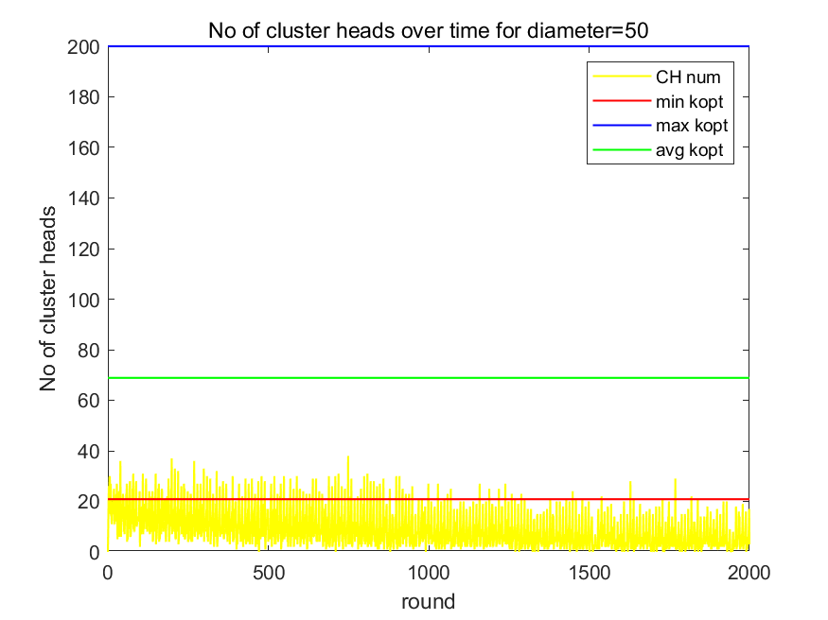
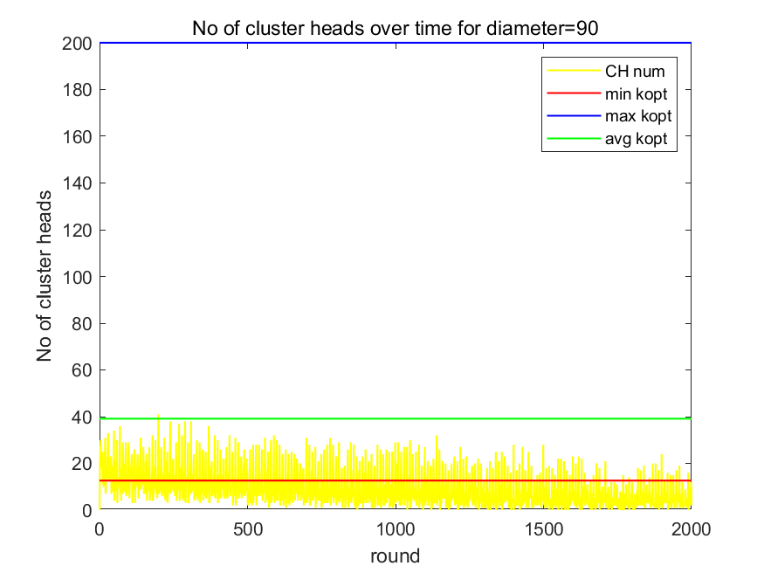
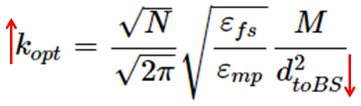
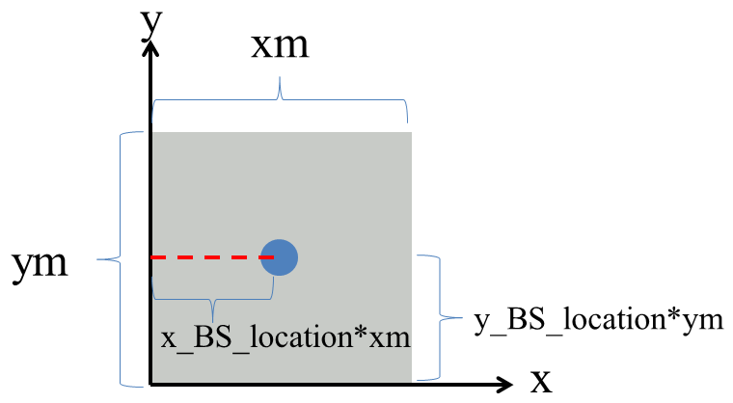

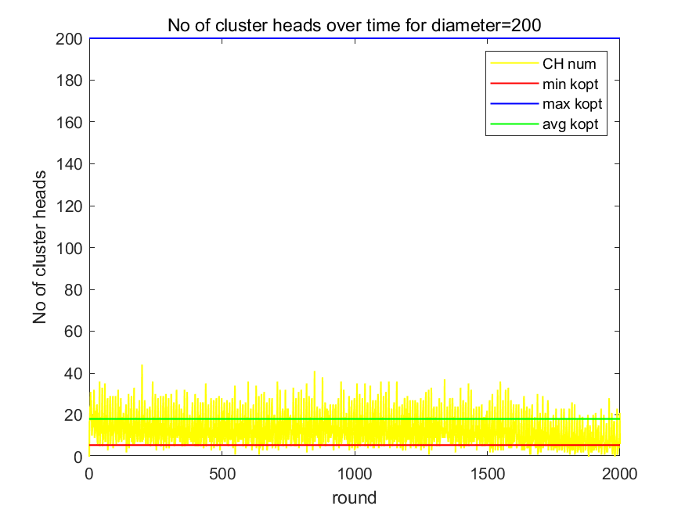
Part 2 – BS Location
Experiment 3: BS inside network
x_BS_location=0.5
y_BS_location=0.5
Notes:
For the 3rd experiment, When base station is located inside the network, the upper bound loses its meaning. The calculated upper bound is larger than the number of nodes and is thus set as 200 (number of nodes). The distance between a node and BS can be really small (node very close to BS), which results in extremely big optimum k value.

Slide 10
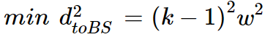
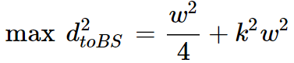
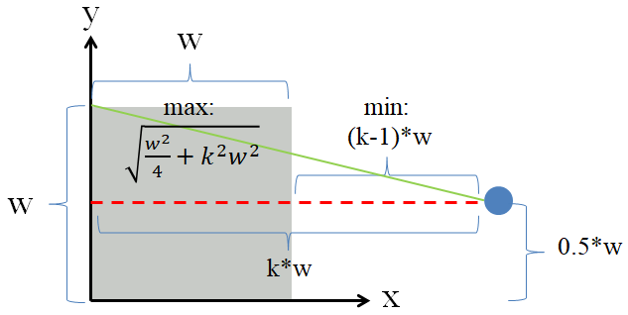
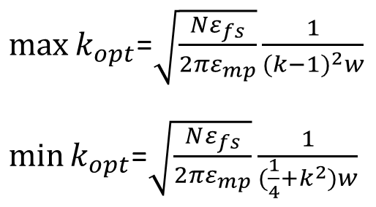
Part 2 – BS Location
Mathematic analysis
Considering validity of optimum k range, for further experiments, BS location is set as:
x_BS_location=1.5
y_BS_location=1.5
Notes:
Assume the network is of width w and length w, and the location of BS is (k*w, 0.5*w). The possible furthest node to BS is at the northwest corner of network.
The possible closest node to BS is at the middle of right boundary.
When k increases (BS is farther from network) or w increases (bigger size of network), the upper bound and lower bound of optimum k range both decrease. When k decreases or w decreases, the upper bound and lower bound both increase. For extreme parameters, such as network size which is too small and BS too far, the theoretical range does not match with the actual number of CHs. And for BS inside of network, the upper bound is meaningless.
Thus, in order to let number of clusters approximately fall between the calculated optimal k range, we choose BS outside of network for further experiments. The location related parameters are set as (1.5,1.5).
Ill pass the time now to Emil

Slide 11
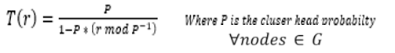
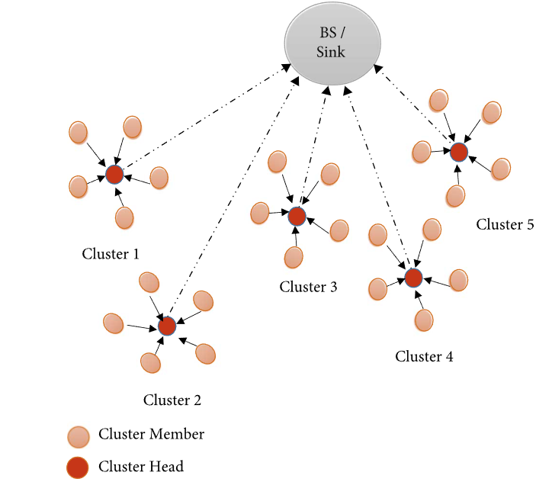

Part 2 – LEACH-C
Improved method of LEACH
Cluster head is still chosen stochastically based on the equation.
Where each node generates random number
Look at the overall network energy
Find average and only those node’s energy more than average can be CHs
Notes:
Thank you Zuona, My name is Emil Yong Kai Wen and I will be presenting on Leach C
Leach C is an acronym for Leach Centralized where it is an improved version of the classical leach as aforementioned by Faisal.
Cluster heads for Leach C are still chosen using the stochastically base approach where each node is tagged with a random number between 0 to 1 in the beginning of the 1/p Rounds.
And this random number is compared with the threshold equation as shown on the right for each round. There is no double counting, once you are considered as a cluster head, nodes are removed from set G.
Where Set G consist of all nodes that are not yet a cluster head.
In leach, the CHs are distributed randomly. Meaning there is no guarantee that leach can ensure good clustering and hence even energy distributed dissipation.
That’s why in LEACH C, an additional criteria is imposed. It (BS) looks at the overall network to have a global knowledge of all alive node’s remaining energy. It calculates the average energy and only considers the cluster head which has remaining energy above the average energy.
Hence this additional condition ensures a well-distributed network to a certain extent unlike classical leach where it may concentrate energy dissipation on certain cluster heads if clustering is bad

Slide 12
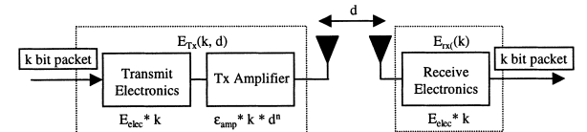
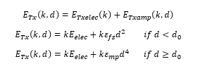
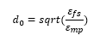
Part 2 – LEACH-C
Uses Simple radio Model for radio hardware energy dissipation
Transmitter : Electronics & Power Amp
Receiver: Electronics
Channel Model :
Free space (d^2)
Multipath (d^4)
Controlled by d0
Depends on distance between transmitter and receiver
Network diameter matters
Notes:
The radio model implemented on leach C uses a simple radio model for radio hardware energy dissipation that runs the radio electronics and the power amplifier when transmitting
For the Receiver, it also dissipates energy to run the radio electronics when it receives data packets from the transmitter.
So The energy dissipation model in LEACH C however its considers two things ➔ free space and multipath fading channel model. Where free space is a power of 2 loss with distance and multipath is power of 4 loss with distance
So to consider which set of energy dissipation, it is controlled by a threshold value d0, and d0 is calculated as squareroot( Efs/Emp)
Therefore, to transmit the data packet of N bits, it actually depends on the distance between the transmitter and receiver WHICH also means, size of the network diameters matters a lot.

Slide 13
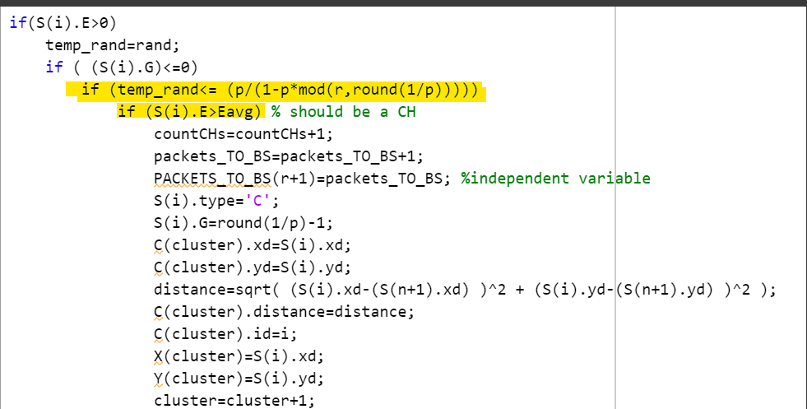
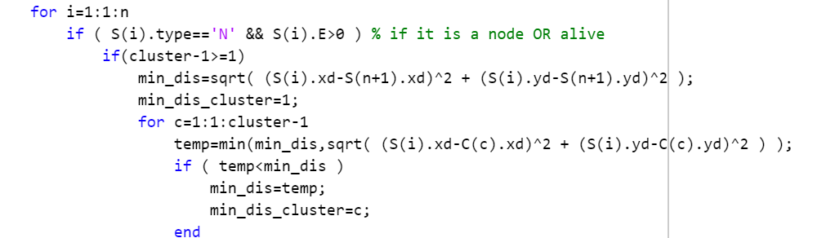
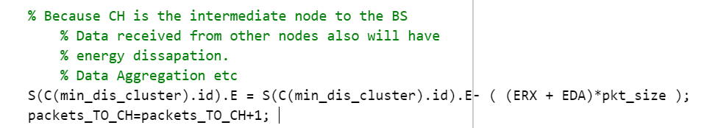
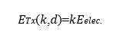
Part 2 – LEACH-C
Cluster head formation :
Check if it is alive
Check if it is in set G
Check random number
Check for remaining energy
Cluster head formation
Cluster formation:
Sum of square distance as distance metrics
Shortest distance = lower energy dissipation
EDA: Consider for data fusion
Cluster head formation
Cluster formation
Receiving Data packet
Notes:
For the coding approach, we follow the parameters in the literature paper but run it for 4000 rounds. S here stands for node and this variable is a structure. So it will first check if this particular node is alive and if it is in the set G first. Meaning, this node must not be considered as cluster head before.
Then , it will check it’s random number. if it is lesser than the threshold value
then it will chenck the node’s remaining energy if it is more than the average energy. These are the condition to form the cluster head.
Once the cluster head is formed , we will use the sum of square distance as the distance metric for cluster formation
Each node will check its distance to all cluster heads for that round and assigned to the cluster head which gives the shortest distance.
Finding shortest distance is important because energy dissipation is exponentially proportional to distance. Finding shorter distance means lesser energy dissipation when transmitting data packet.
Note that for the cluster head receiving energy, there is an additional energy consideration. Called EDA where we consider the energy required for data fusion when CHs receives data packet from nodes in its cluster

Slide 14
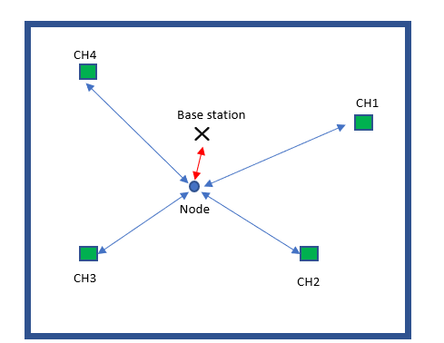
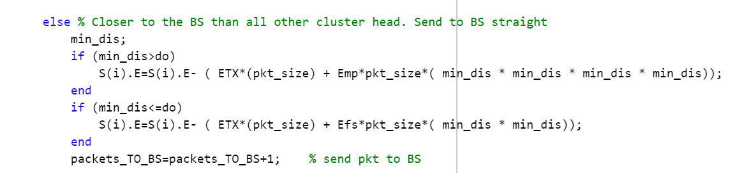
Part 2 – LEACH-C
Cluster head as intermediate node and data fusion
Compacts and summaries data for the base station
Reduce complexity and computational load for BS
Larger network CHs is good
Provide fully connected network
Shortest path
Nodes closer to BS, send it directly don’t use CH, wasting energy dissipation
Notes:
Now, we have seen that CH takes up an important role as an intermediate node for nodes to transmit data packet to the base station. It performs local preprocessing from all member nodes in the cluster Basically, data fusion.
Depending on application , data fusion is important because it compacts and summaries the information for the base station. This reduces the complexity and computational load for the base station.
In large network diameter, cluster head is definitely useful because it allows us to establish a fully connected network with shortest path routing and lower energy dissipation from sensor nodes to BS.
So if our context is energy efficiency. in smaller diameters network like 10meters, with the same number of nodes 100, using cluster head MAY not be that ENERGY efficient.
So, in terms of programming approach, we tweak the skeleton code abit. We consider a case where by the node is closer to the base station than all cluster head.
As you can see, this node is closer to the base station. Since the ultimate objective is to send the packet to the BS, the node will send it directly to the BS instead of wasting energy to the CHs and then to the base station. Of course one draw back is that this will incur higher computational load for the BS. So this is very application dependent. See what you want to priorities.

Slide 15
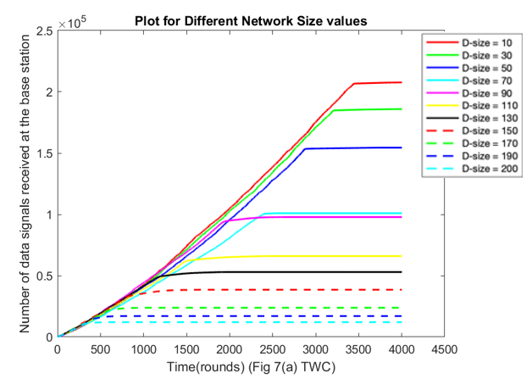
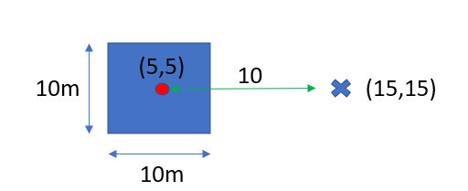
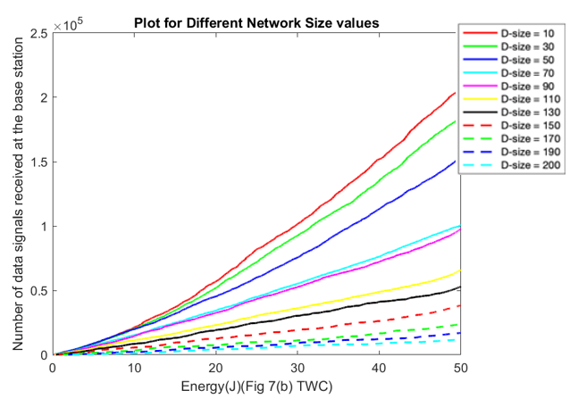
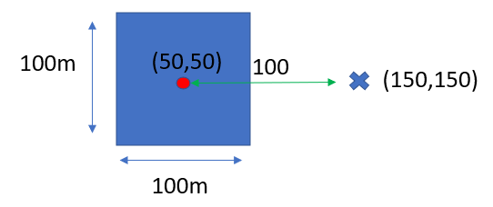
Part 2 – LEACH-C
Data delivery to the BS is inversely proportional to the BS
Base station in smaller network receives more data packet
Main reason : Distance
Lives longer and more energy efficient
An increase in diameter equates to exponential increase for energy dissipation
Larger network model likely to use multipath modelling
Notes:
Based on the two plots, we can see that data delivery is inversely proportional to the network diameter.
At smaller network diameter the number of data packet received by the BS is more than larger network diameters
Main reason: Cluster nodes in smaller diameters lives longer because data transmission requires shorter path, hence naturally send more data. Also, nodes in smaller diameter send its data directly to the BS since it is more efficient
But as we increase the network diameter,
A small increase is network diameter is an exponential increase for energy dissipation since the energy is a power factor of distance.
As u can see a factor of 10 increase is an increase of 100 or 10,000 in term of energy dissipation because of the energy model used
Hence, this means that larger network diameters, nodes tends to dies more easily.

Slide 16
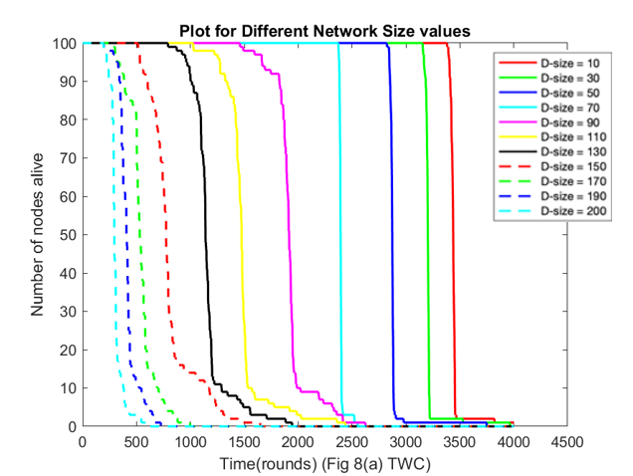
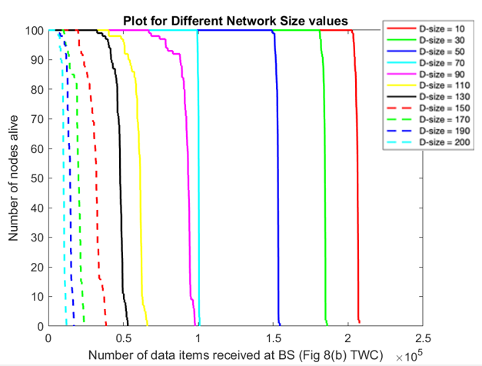
Part 2 – LEACH-C
Larger network:
More dead nodes
Lesser data packets
BS for larger network has lesser computational and complexity load
Leach C
Notes:
The two plots here shows the nodes alive vs rounds and data received by the BS
Similarly larger network size have more dead nodes and lesser data packet received at the BS vs smaller network.
This also shows that for larger network size, the computational and complexity load on the BS is lesser because
Number of data packet is lower because most nodes are dead.
Data received might have already been pre-processed.

Slide 17
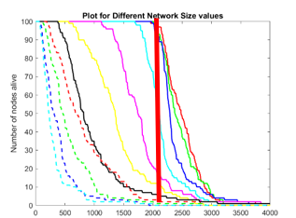
Part 2 – LEACH-C
Larger network:
More dead nodes
Lesser data packets
BS for larger network has lesser computational and complexity load
Life time defination: looking at the first death
Leach vs Leach C
First death occurs at much later round than Leach
Dies together
Evenly distributed
Leach C
Leach
Notes:
In addition, if we have quick look at the first onset of death between leach and leach C.
Leach C tends to occurs at a later round as compared to the Leach. For the red solid line, leach first death is at 2100, but leach C is around 3500.
There are many variations to determine life time. If life time is determined by first onset of death, then leach C life time is longer than leach as shown on the plot
NOW, We can also see that the slope is very steep in leach C. The occurrence of first death and all dead is just a matter of few rounds unlike leach.
This is good because Dying tgt means that workload is shared evenly among all nodes which is what we want
Unlike leach where the first node and all dead nodes are quite apart.

Slide 18
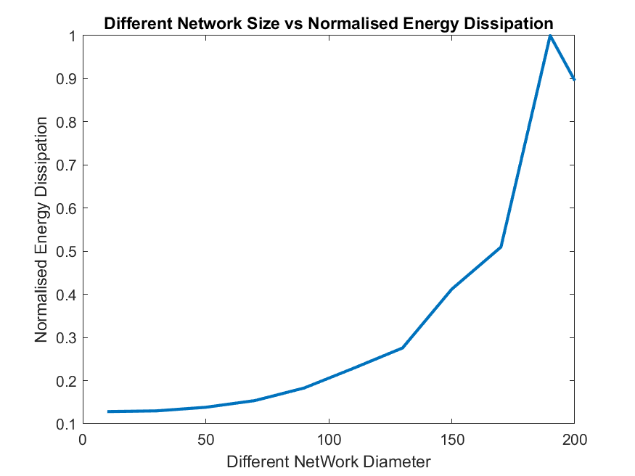
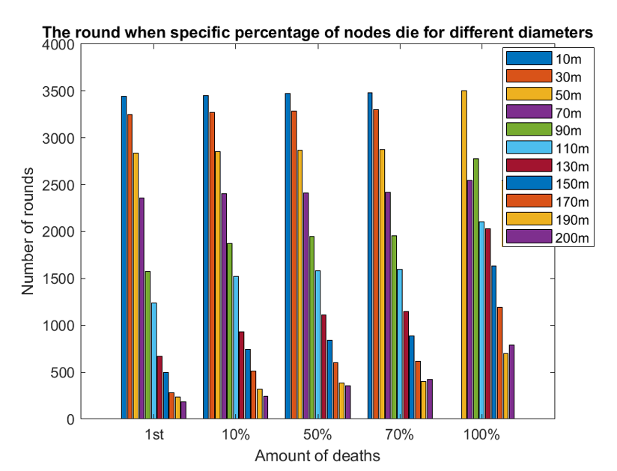
Part 2 – LEACH-C
Reinforce that larger network incurs larger energy dissipation
Started off gentle and becoming steeper as network size increase
Due fading and multipath model for energy dissipation
Notes:
And lastly , the figure on top shows the Different network diameter vs normalized energy dissipation.
This plot reinforces the idea that larger network incurs larger energy dissipation since energy dissipation is dependent on distance.
Also, this graph started off gentle and then becomes steep. This phenomenon is because of the fading and multipath model for energy dissipation.
It is gentle because when distance is small. The power is 2 but when distance is big, the power is 4. Quadratic.
This graph below shows the rounds at which the networks of various diameters for different percentages of node deaths.
Same thing , We can observe again that the larger networks, it is more more vulnerable to network death.
Also the first occurrence of death and all death nodes are within a few rounds. If you draw a line on the height of all the graph, it is quite flat as compared to leach
That’s all for leach C and I wil pass the time now to ivander.

Slide 19



Part 2 – BCDCP
Improvement from LEACH and LEACH-C
Uniform placement of cluster heads to minimize distance of packet transmission
Performs balanced clustering where every cluster have roughly the same nodes
Using CH-to-CH routing to save packet transmission distance further
Fuses data packets to increase data compression
Notes:
Thank you Emil. I’m Ivander and I will now explain about BCDCP.
BCDCP is the successor of LEACH-C.
It is a centralized WSN algorithm that covers where LEACH-C misses out.
The paper by Siva Murugunathan, et al. titled A centralized Energy-Efficient Routing protocol for Wireless Sensor Networks in 2005, shows that BCDCP outperforms other protocols.
- It has uniform placement of cluster heads to minimize distance of packet transmission
- It performs balanced clustering where every cluster have roughly the same nodes
- It uses CH-to-CH routing to save packet transmission distance further
- It fuses data packets to increase data compression
I will continue with discussing how we have extended the LEACH sekeleton code into BCDCP.

Slide 20

Part 2 – BCDCP
CH Candidate Selection:
Creates a set of cluster head candidates with nodes that have E > Eavg
Store these nodes in temp_S
Note that addition of tolerance is to reduce rounding errors in matlab
Similar to LEACH-C
Filtering of nodes
Notes:
The first modification is the cluster head candidate selection.
BCDCP filters out nodes that are lower than average, and keeps ONLY those with higher than above average energy as cluster head candidates.
In the code, we store the nodes in an array temp_S.
This is similar to LEACH-C.

Slide 21



Part 2 – BCDCP
Cluster creation
Largest cluster split into two smaller balanced clusters
Repeat until there are Nch clusters
Creation of clusters
Notes:
Then, we proceed to cluster creation.
BCDCP then proceeds to split the nodes into clusters,
It splits the initial 1 cluster into two balanced clusters. Then takes the larger cluster and splits it again into two.
Afterwards it takes the largest cluster out of the three, and splits it into two.
This is repeated until there are Nch total clusters.
As you can see in the code, the clusters-array stores clusters, and the cluster heads keep track of which cluster heads are chosen after every split.
The loop will break if there are Nch clusters or when there are no more clusters that can be split.
The splitting is implemented by the twoClustering method, which is written with reference to the research paper, step 1 to step 4.

Slide 22


Part 2 – BCDCP
Cluster creation
Largest cluster split into two smaller balanced clusters
Repeat until there are Nch clusters
Two furthest nodes in the cluster to be cluster heads
Split the nodes based on distances to the cluster heads put in c1 and c2
Spatial selection of two CHs
Cluster splitting
Notes:
,
Based on step 1 and step 2 in the paper:
As seen in the code “Spatial selection of two CHs”
We first get the two furthest nodes in the cluster to be cluster heads, by iterating through all the nodes in the cluster, and get two points with the largest distance between them value, stored in dist.
The two furthest nodes are chosen as cluster heads, ch1 and ch2.
In the next code snippet of “Cluster splitting”, The remaining points are split in c1 or c2, depending on which cluster head out of the two that they are closer with.
This outputs two clusters, c1 and c2.
Second, we do cluster splitting. The remaining nodes are split in the cluster c1 or c2, depending on which cluster head they are closer with.

Slide 23


Part 2 – BCDCP
Cluster creation
Largest cluster split into two smaller balanced clusters
Repeat until there are Nch clusters
Two furthest nodes in the cluster to be cluster heads
Split the nodes based on distances to the cluster heads put in c1 and c2
Equalize number of nodes in the cluster
Result is two clusters, ch1 & ch2
Notes:
The size of c1 and c2 might not be balanced yet, though. One might be larger than the other.
To balance the sizes, the code calculates the size difference, diff – and moves a number of diff/2 nodes from the larger cluster across to the smaller one.
The nodes are not picked randomly, but instead based on whichever node has the closest distance to the opposite cluster head.
The result of the balanced clustering is two clusters, c1 and c2.
The result of the balanced clustering is two clusters with ch1 and ch2 as their cluster heads.

Slide 24




Part 2 – BCDCP
CH-to-CH Path Formation:
Creating paths from each CH to the base station via CH-to-CH hops
Uses MST formed by all the CHs.
Edges have weight equal to distance, nodes are CHs.
Implemented using MATLAB's graph objects and methods.
Transfers aggregated data
Notes:
Lastly, after the clusters are formed, BCDCP creates path from each CH to the Base station via CH-to-CH hops, to transfer data to the base station.
The hops correspond to the path in MST formed by CHs. To implement this, we transformed the CHs, from 2d plane to an undirected graph, with weight of edges the distances between CHs, and nodes are CHs.
The minspantree method and shortestpath method is used to generate the graph & get the path to the base station.
One node is then chosen at random, to send data to the base station. We call it main_ch.
We can see more clearly in the following simulation.

Slide 25

Part 2 – BCDCP
The Cluster Head selection & Routing of BCDCP in action
Notes:
This animation shows how our BCDCP implementation is working.
It spatially distributes clusterheads,
It creates a minimum spanning tree of CHs,
And it randomly selects the main clusterhead to handle transmission to the base station in the upper right corner.
Ill pass over the time now to zhu qi

Slide 26


Part 2 – BCDCP Simulation Results
Data delivery inversely proportional to network diameter
Less efficient data delivery in larger network
E0=0.5J, n=100, r=4000, BS (1.5xm, 1.5ym)
Notes:
Thank you Ivander for presenting the BCDCP theory & code. This is Zhu Qi to continue evaluate the BCDCP simulation result.
To evaluate the simulation performance of BCDCP, the parameters are chosen with initial energy E0=0.5 Joules, number of nodes within the WSN n=100, number of simulation epoch r=4000 rounds, with the BS located at (1.5 xm, 1.5 ym).
Figures in this slide are showing the simulation result of number of data packets received at the BS versus time and energy, for different network sizes. Following the same legend, we use the solid red line to denote the smallest network (d=10m), while the largest network (d=200m) is shown by dotted light blue line.
From figure on the left, we found a similar trend observed in LEACH and LEACH-C as shown in the pervious slides. For example at the 2000th round, for the smallest network, number of data packets received at the BS is approximately 5 times as much as the largest network.
Therefore, this reassures data delivery to the BS is inversely proportional to network diameter. This effect is also seen from the figure on the right, where the number of data packets reaching at the BS is lesser when the network size is larger for any given amount of energy. In conclusion, overall data delivery is inefficient in a larger network size.

Slide 27



Part 2 – BCDCP Simulation Results
Network lifetime & total data delivery is lesser for larger networks
Notes:
The improvement gained through BCDCP is further exemplified by the system lifetime graph. The 1st & 2nd plot illustrates between a total number of nodes alive versus data items received at BS and # of rounds, with different network diameters.
While the 3rd plot presents a clearer horizontal comparison between the number of rounds when number of nodes die among different network sizes showing in the legend.
It is obvious that there is a similar trend between the first 2 plots due to the earlier mentioned reason, energy dissipation of each node is directly proportional to the distance between each node.
Therefore, the number of nodes in a network with a smaller size remains alive for a longer time, which results in more data packets being received at the BS.
With network diameter D-size =200m, the number of alive nodes drop drastically at the 10th round with only a small number of data packets have been transmitted to the BS. On the contrary, this drop-phenomenon only started at later time, with around 8x more data packets transmitted to the BS when D =10m.
Lastly, With a clearer horizontal comparison in the last plot, the number of rounds when the nodes die in the network appear much earlier with a larger network size, which further supports the findings in our previous 2 plots.

Slide 28


Part 2 – BCDCP Simulation Results
Notes:
Lastly, an exponentially increasing trend of normalized energy dissipation versus network diameters is showing in this figure.
When D = 20~150, the growth trend is slow, however, after D-size>170, there is a sharp increase followed.
We assume that the difference between the growing speed might be due to the threshold distance d0.
In BCDCP, we use both the free-space propagation model and the two-ray ground propagation model to approximate the path loss due to wireless channel transmission as shown in Equation 2.
Given a threshold transmission distance of d0, the free space model is employed when d≤ d0 which results in square growth. However, when d>d0, the two-ray model is being adapted which results in a quadratic aggressive growing trend in energy dissipation.
Another point that needs to be mentioned here is, there is a growing trend slowing down during D = 150~170, we assume this might be due to radio model changing phase.
Now, I will pass down the time to Yuyi for giving a final conclusion of all 3 protocols.

Slide 29



Comparison of All 3 Protocol Performance
BCDCP & LEACH-C have higher data delivery
 | LEACH | LEACH-C | BCDCP
Data magnitude | 10⁴ | 10⁵ | 10⁵
LEACH
LEACH-C
BCDCP
Notes:
Thanks Zhuqi, this is Tang Yuyi, now we will move onto the final evaluation part.
In order to compare the performance of all 3 protocols in this research, which are LEACH, LEACH-C and BCDCP, we combine the simulation results together. It’s noticed that for fair comparison, LEACH will be simulated using the same radio model computation that considers free space or multipath effects.
Similarly, the BS is located outside the network with a distance factor of 1.5 times of network diameter to be consistent with LEACH-C and BCDCP. The number of rounds will be 4000 and all other parameters will follow the ones used in Part 2.
Here as we can see now, the first 3 plots show the number of data signals received at the BS over the number of rounds. We can observe the similar trends that the received packets number rise linearly as the time increases until the energy runs out and nodes die.
Besides, the magnitude order for data delivered with LEACH is 10^4, while it is 10^5 for both LEACH-C and BCDCP, and BCDCP shows slightly higher value.
BCDCP enjoys better performance due to its cluster balancing algorithm that ensures equal cluster size and spatial distribution as compared to LEACH and LEACH-C which randomly distributes clusters.
Additionally, the CH-to-CH routing helps in keeping energy cost low in large networks.

Slide 30



Comparison of All 3 Protocol Performance
BCDCP & LEACH-C - longer network life but faster death rate
At d=90 | LEACH | LEACH-C | BCDCP
First death | 1100 | 1500 (35% ↑ than LEACH) | 1750 (60% ↑ than LEACH)
LEACH
LEACH-C
BCDCP
Notes:
Next, we will focus on the lifetime of nodes as the time increases. In these plots, we can see that LEACH-C and BCDCP improves the network longevity in terms of the first onset of node death.
For example, when the diameter of the network is 90 meters, the first death occurs at 1100 rounds for LEACH, 1500 rounds for LEACH-C, which is 35% longer than LEACH, and 1750 rounds for BCDCP, which is 60% longer than LEACH.
Besides, both LEACH-C and BCDCP face faster network death upon first death illustrated by the steep slopes. This phenomenon can be explained since they all utilize the BS for cluster formation.
At the beginning of each round, the BS receives the information of the location and energy level of each node, so that it can calculate the average energy and then assign the nodes with relatively higher energy to be the CH.
In this way, they can distribute the burden of sending messages evenly among all nodes, so that all nodes die at similar times.

Slide 31
Conclusion
LEACH-C and BCDCP are more energy-efficient than LEACH by having a better CH-selection based on remaining energy and location of nodes.
Both BCDCP and LEACH-C do well in distributing the burden of sending messages evenly among all nodes, so that all nodes die at similar times.
BCDCP is able to extend longevity of network due to its CH-to-CH spanning tree routing and cluster balancing that ensures equal cluster size and spatial distribution of clusters.
Notes:
At the end, I will make a brief conclusion.
In this project, we investigated the improvements in network performance with the use of LEACH variations, namely LEACH-C and BCDCP.
We confirmed the theoretical understanding that LEACH-C and BCDCP are more energy-efficient by having a better CH selection based on remaining energy and location of nodes.
Besides, both BCDCP and LEACH-C do well in distributing the burden of sending messages evenly among all nodes, so that all nodes die at similar times.
Meanwhile, BCDCP increases longevity of network furthermore with its CH-to-CH spanning tree routing and cluster balancing that ensures equal cluster size and spatial distribution of clusters.
Thus, BCDCP performs the best of the three in terms of network longevity and data delivery.

Slide 32
Thank You!
Notes:
That’s all for our presentation, thanks for listening!

